Slide 1
Linear Algebra

Slide 2
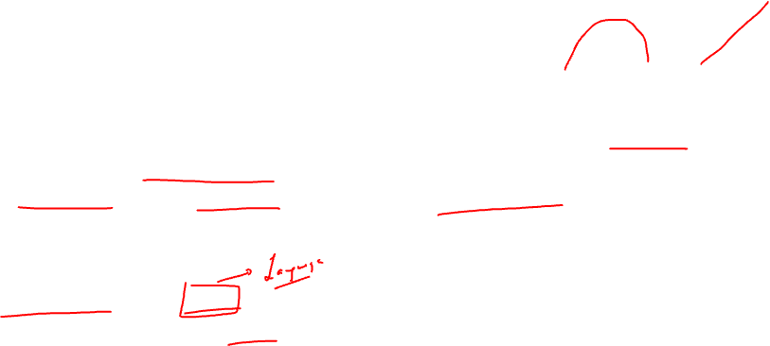
Definition
Linear Algebra is the branch of mathematics that studies vector spaces and linear transformations between vector spaces, such as rotating a shape, scaling it up or down, translating it (ie. moving it), etc.
Deep Learning & NLP relies heavily on Linear Algebra, so it is essential to understand what vectors and matrices are, what operations you can perform with them, and how they can be useful.

Slide 3
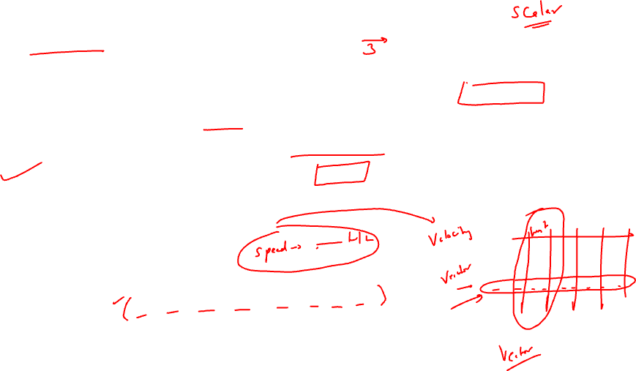
Vectors
A vector is a quantity defined by a magnitude and a direction. For example, a rocket's velocity is a 3-dimensional vector: its magnitude is the speed of the rocket, and its direction is (hopefully) up.
A vector can be represented by an array of numbers called *scalars*. Each scalar corresponds to the magnitude of the vector with regards to each dimension.

Slide 4

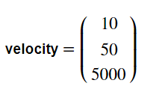

For example, say the rocket is going up at a slight angle: it has a vertical speed of 5,000 m/s, and also a slight speed towards the East at 10 m/s, and a slight speed towards the North at 50 m/s. The rocket's velocity may be represented by the following vector:

Slide 5
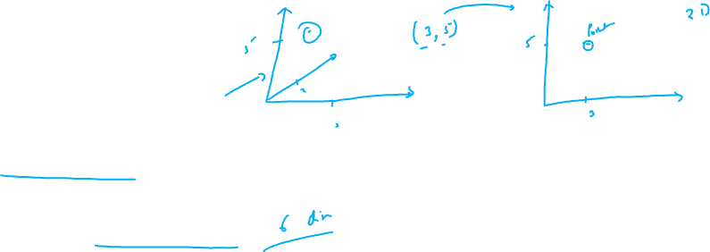
A list of N numbers may also represent the coordinates of a point in an N-dimensional space, so it is quite frequent to represent vectors as simple points instead of arrows.
Example: A (1, 2, 3, 4, 5, 6)
So here A represents a point in 6 dimensional space and hence it has 6 co-ordinate values.

Slide 6
Purpose
Vectors have many purposes in Machine Learning, most notably to represent observations and predictions.
For example, say we built a Machine Learning system to classify videos into 3 categories (good, spam, clickbait) based on what we know about them. For each video, we would have a vector representing what we know about it, such as:
video
10.5
5.2
3.25
7.0

Slide 7
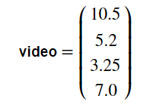
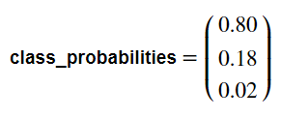
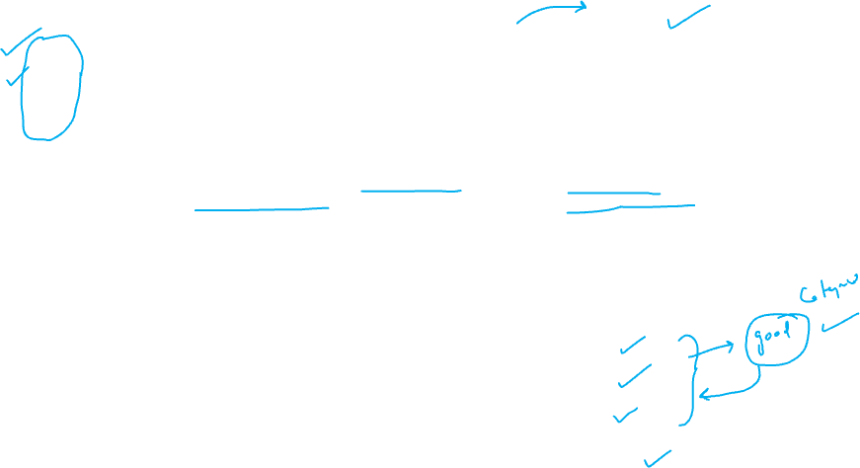
video
10.5
5.2
3.25
7.0
This vector could represent a video that lasts 10.5 minutes, but only 5.2% viewers watch for more than a minute, it gets 3.25 views per day on average, and it was flagged 7 times as spam. As you can see, each axis may have a different meaning.
Based on this vector our Machine Learning system may predict that there is an 80% probability that it is a spam video, 18% that it is clickbait, and 2% that it is a good video. This could be represented as the following vector:
class_probabilities
0.80
0.18
0.02

Slide 8


Vectors in python
In python, a vector can be represented in many ways, the simplest being a regular python list of numbers.
Since we plan to do quite a lot of scientific calculations, it is much better to use NumPy's `ndarray`, which provides a lot of convenient and optimized implementations of essential mathematical operations on vectors. For example:

Slide 9

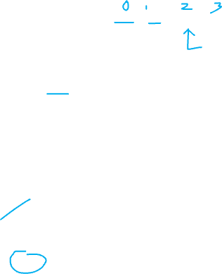
The i^{th} element (also called *entry* or *item*) of a vector
Note that indices in mathematics generally start at 1, but in programming they usually start at 0. So to access programmatically, we would write:

Slide 10

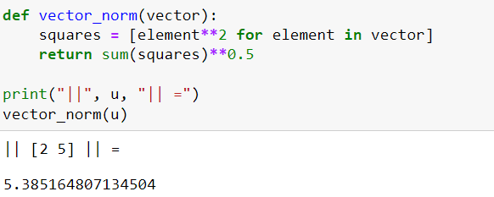
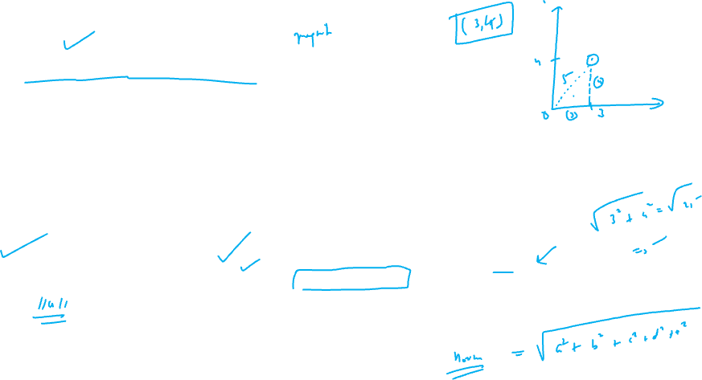
Norm of a vector
The norm of a vector, noted ||u||, is a measure of the length (a.k.a. the magnitude) u. There are multiple possible norms, but the most common one (and the only one we will discuss here) is the Euclidian norm, which is defined as:

Slide 11
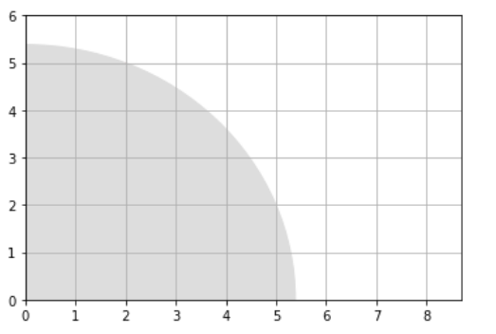

Visualization of norm (magnitude)

Slide 12
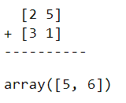
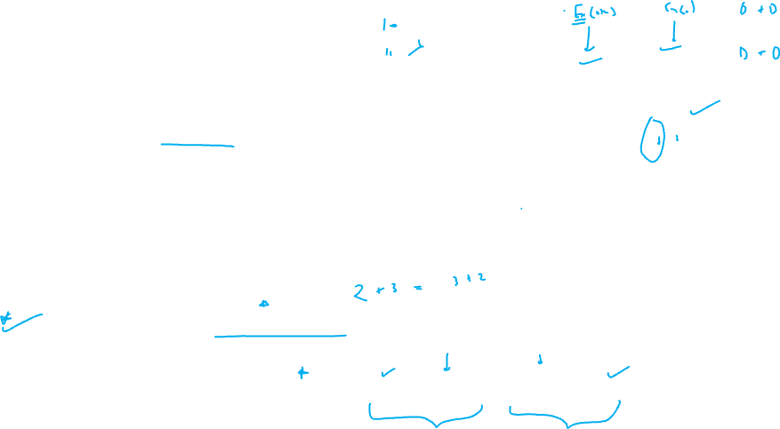
Addition of vectors
Vectors of same size can be added together. Addition is performed elementwise:
Vector addition is commutative: u + v = v + u
Vector addition is also associative: u + (v + w) = ( u + v) + w

Slide 13
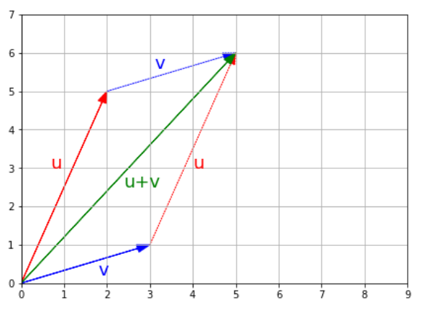
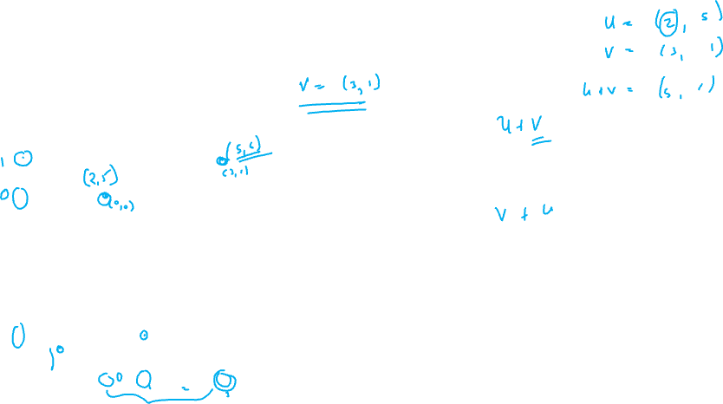
Visualization of addition of vectors

Slide 14
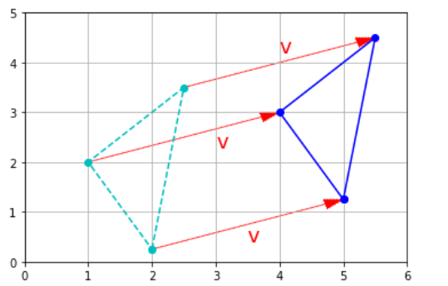
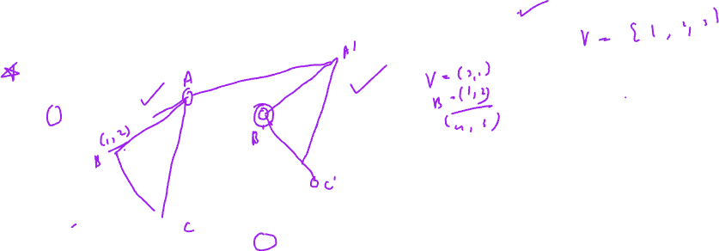
If you have a shape defined by a number of points (vectors), and you add a vector {v} to all of these points, then the whole shape gets shifted by {v}. This is called a geometric translation

Slide 15

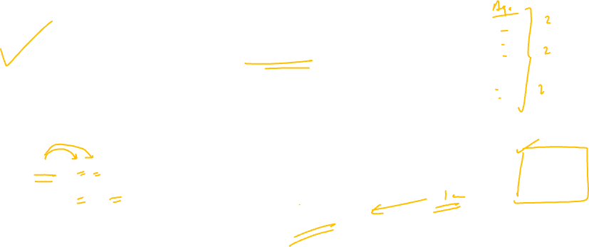
Multiplication by a scalar
Vectors can be multiplied by scalars. All elements in the vector are multiplied by that number, for example:

Slide 16
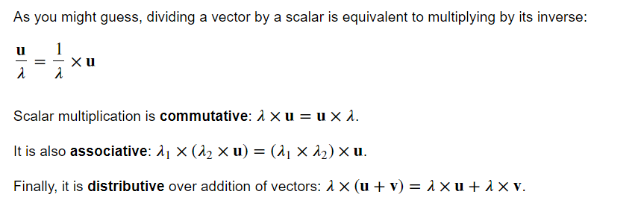
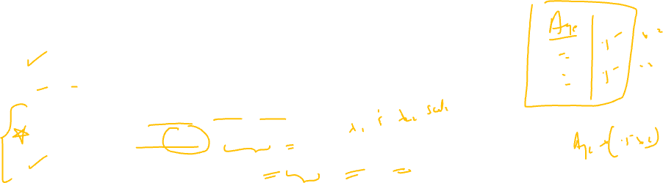

Slide 17
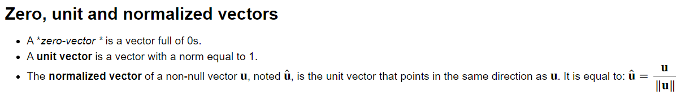
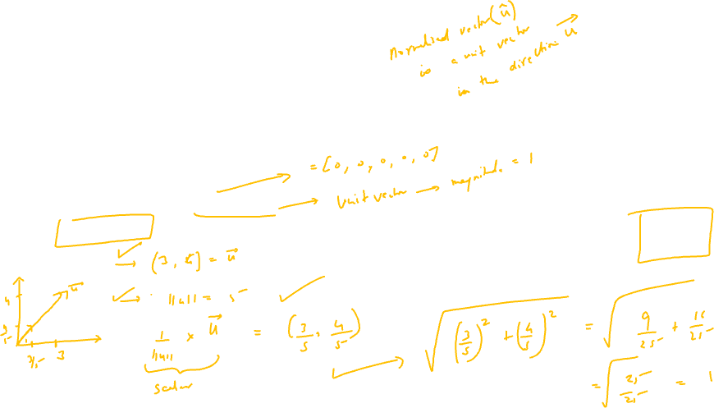

Slide 18
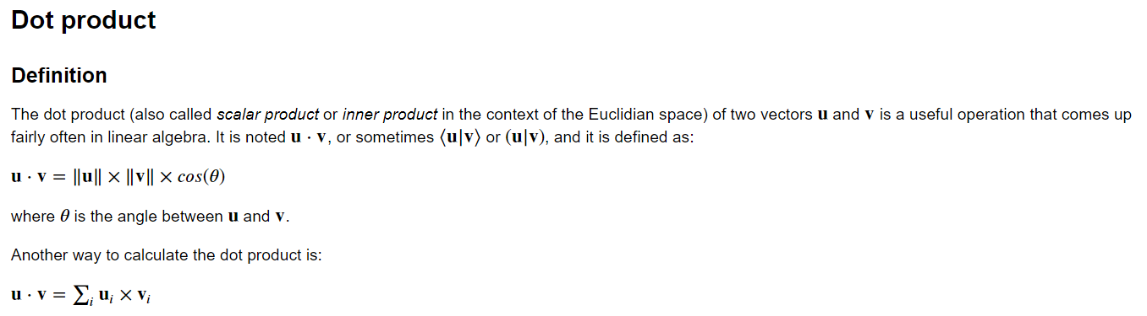
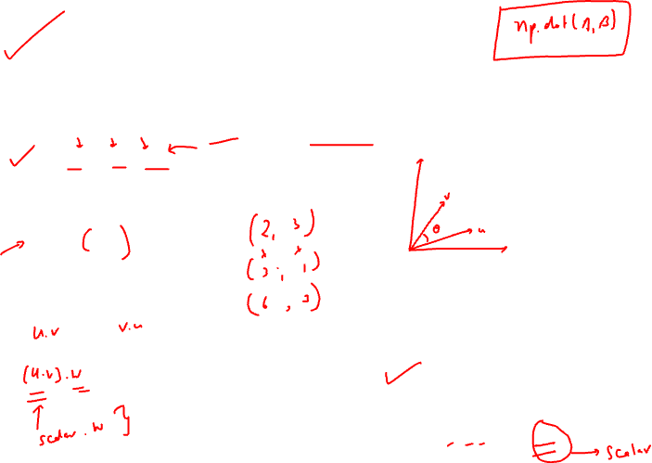
Example:
U = [2 , 5]
V = [3 , 1]
U.V = (2*3 + 5*1) = 11

Slide 19
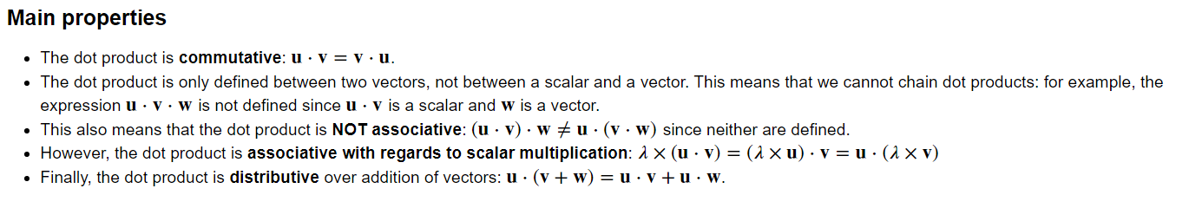
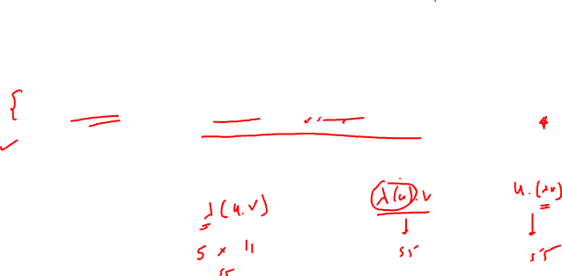

Slide 20
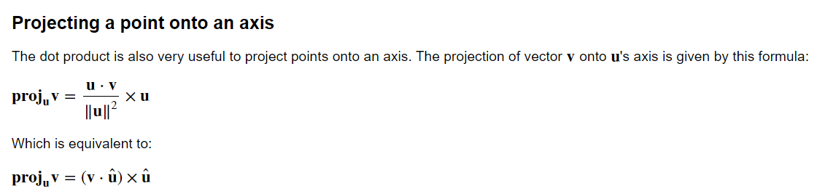
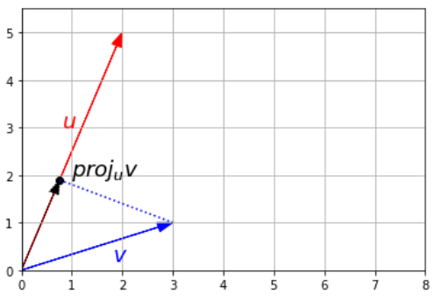
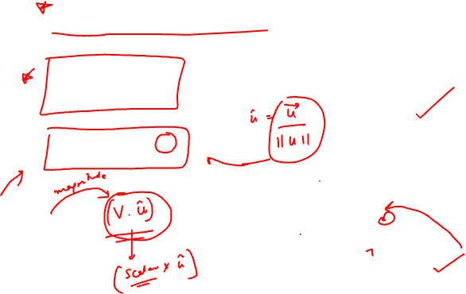

Slide 21
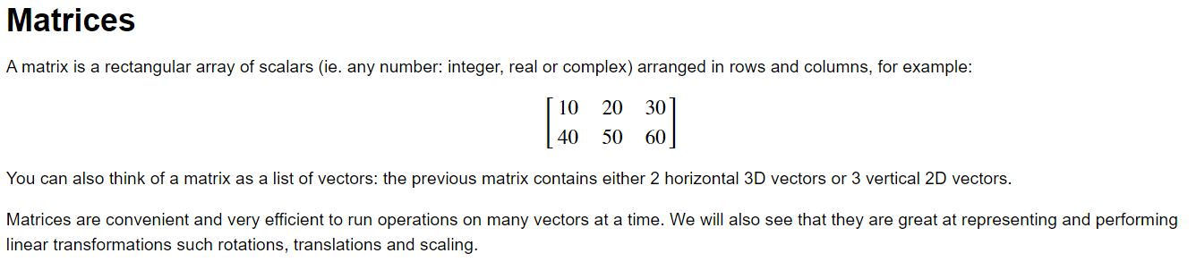
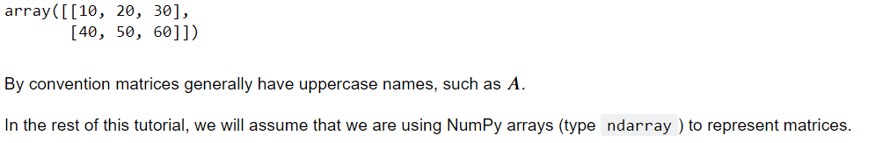
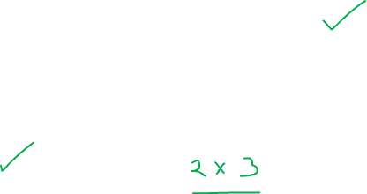

Slide 22
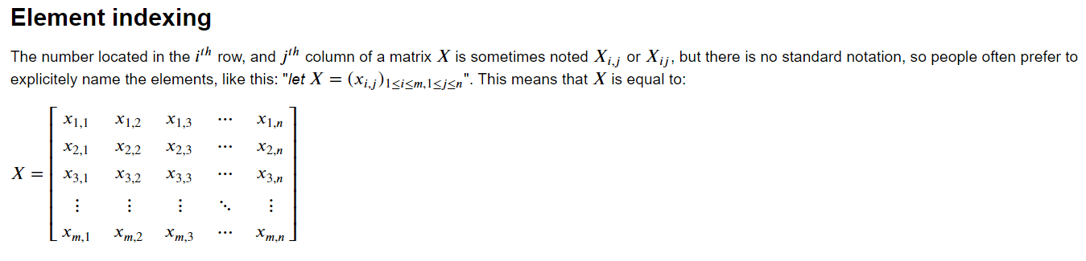
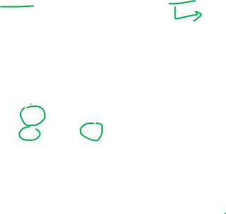

Slide 23
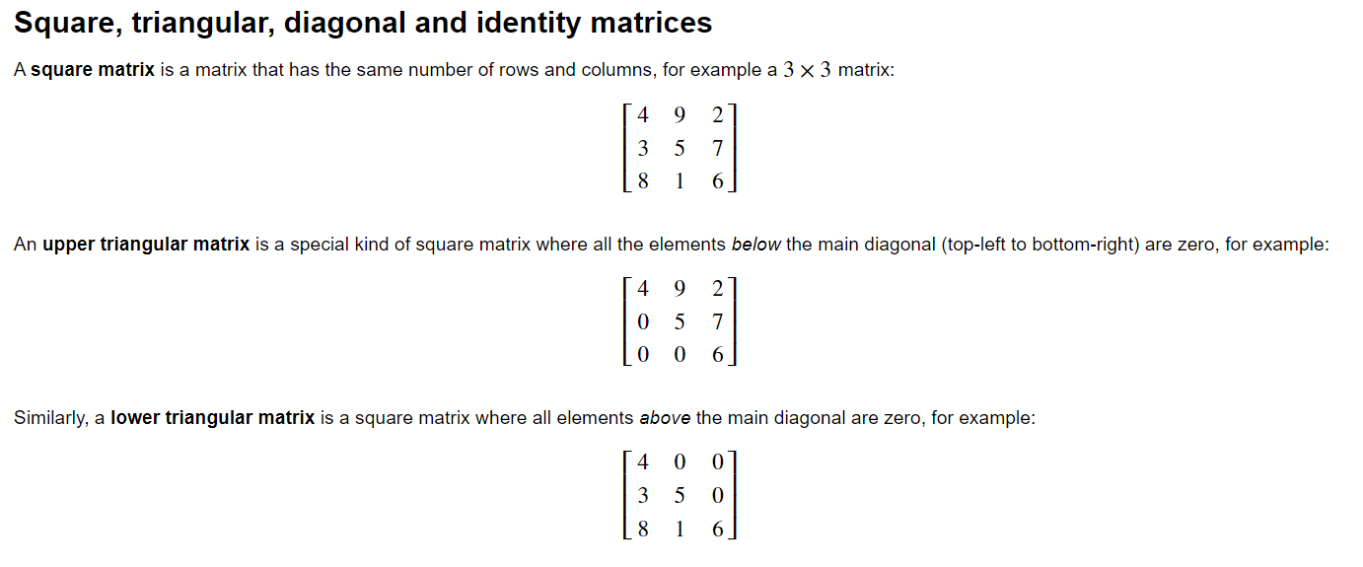
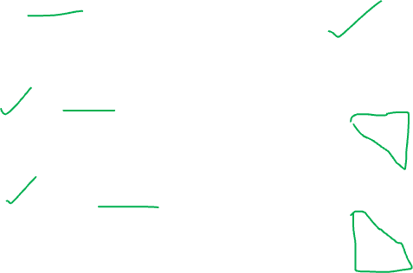

Slide 24
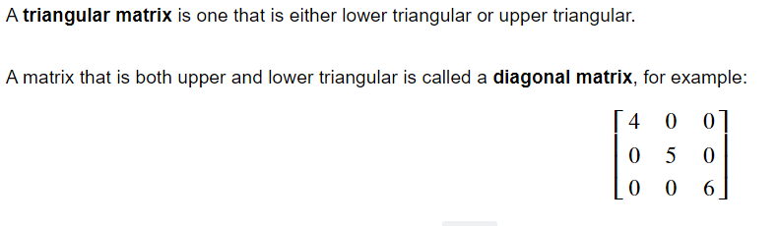
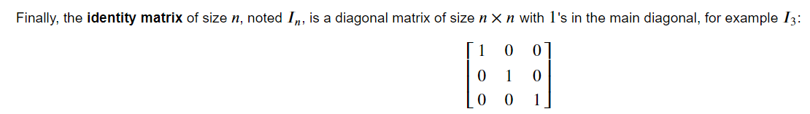
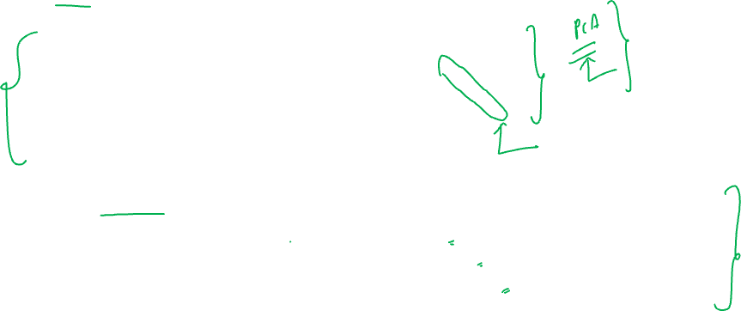

Slide 25
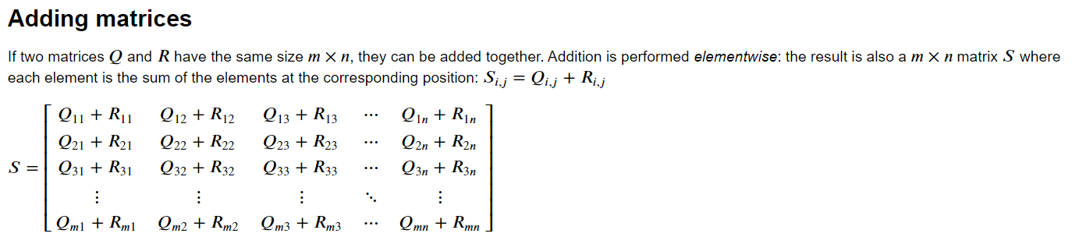
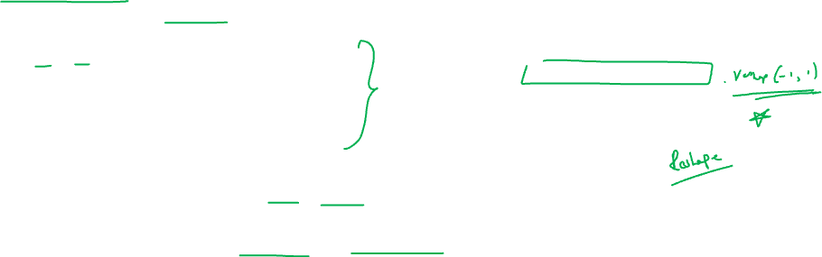

Slide 26
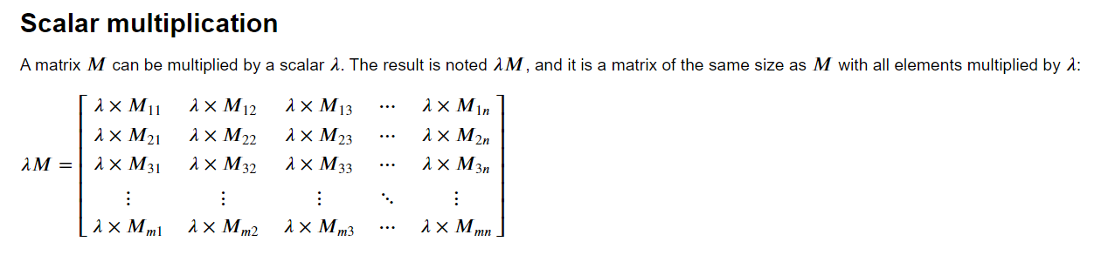

Slide 27
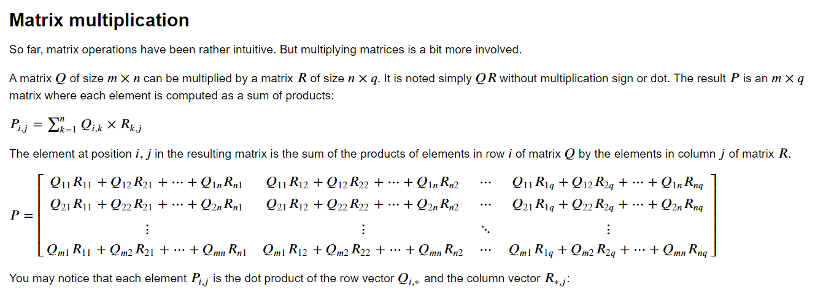

Slide 28
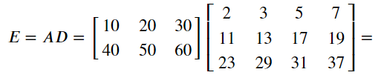
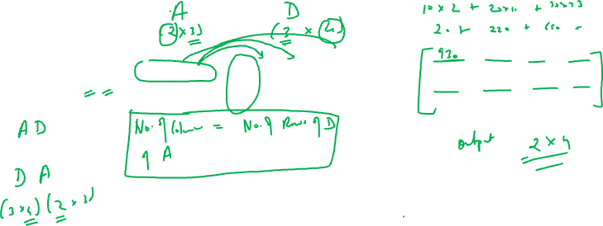

Slide 29
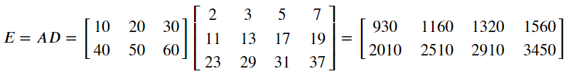
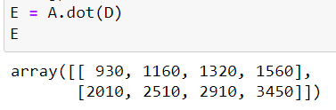


Slide 30
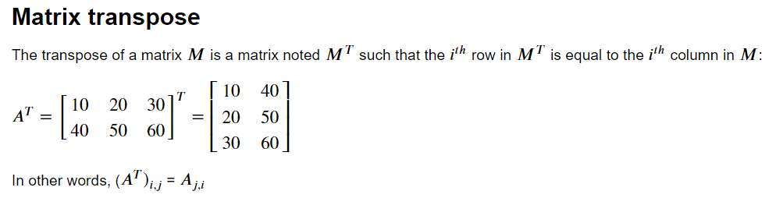
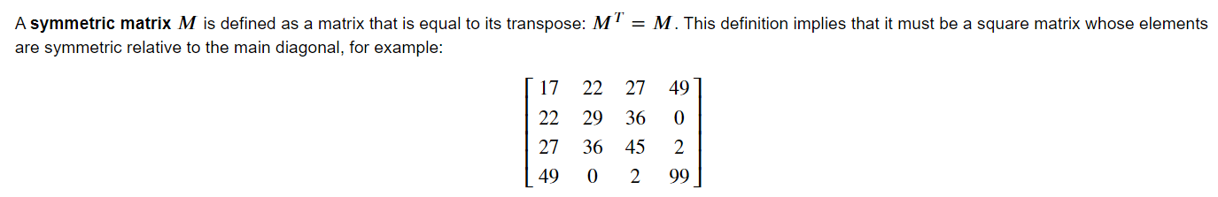
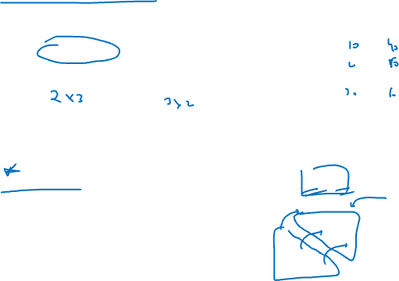

Slide 31


Determinant

Slide 32



